Slide 1
Welcome to CS4222 PSLG!
With Robert and Jakub

Slide 2

Java Python!​​
Hello world!​
Java:​
Public class helloWorld{​
Public static void main(String[] args){​
System.out.println(“ugh are we there yet?”);​
}​
}​
Python:​
Print(“Hello World ☺”)​
Notice:​
No semicolon​
No curly brackets​

Slide 3
Data Types​​​
Don’t exist! (they’re inferred)​
Java:​
int age = 21;​
String name = “Todor”;​
Python:​
Age = 21​
Name = “Todor”​
Notice:​
No declarations​

Slide 4
Conditionals​​​​
Java:​
Int health = 100;​
If (health <= 0){​
System.out.println(“you are dead”);​
}​
Python:​
Health = 100​
If health <= 0:​
Print(“you are dead”)​
Notice:​
No brackets​
INDENTATION! ← very important!​

Slide 5
Conditionals​​​​
Java:​
Else if​
&&​
||​
!​
Python:​
Elif​
And​
Or​
Not​
Do not forget:​
No brackets​
INDENTATION! ← very important!

Slide 6
Loops​​​​​
Java:​
for(int I = 0;i<10;i++)​
while (true)​
Python:​
List = [“item 1”, “item 2”]​
Health = 100​
for item in List:​
print(item)​
while health > 0:​
print(health)​
What do you notice?​

Slide 7
Nested Loops​​​​​
Java:​
for(int I = 0;i<10;i++)​
for(int j = 0;j<10;j++)​
Python:​
for I in range(len(treasure map):​
for j in range (len(treasure map[i])):​
Create a 2d grid with a treasure in the form of an X and find it using nested for loops

Slide 8
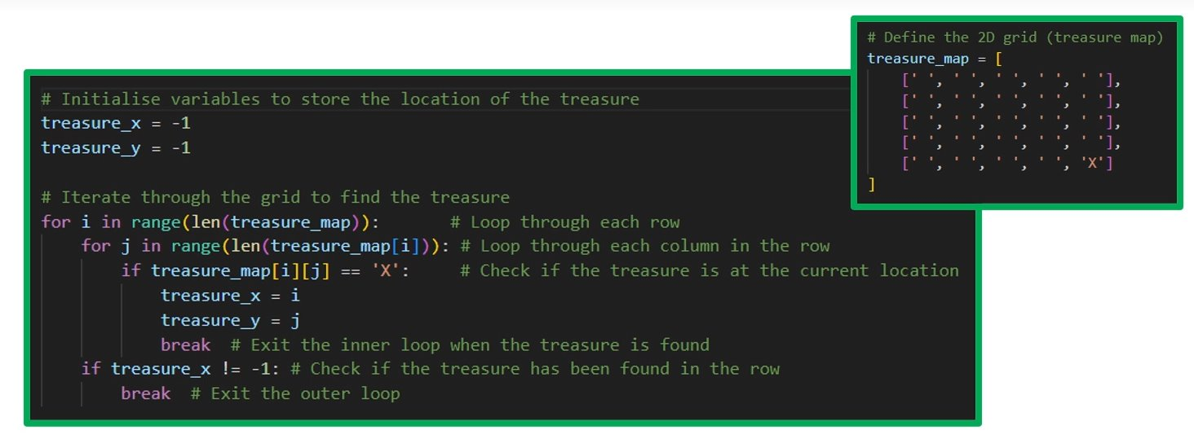
Answer:

Slide 9
Functions​​​​​​
Java:​
String greet (String name){​
return “Hello ”+name+”!”;​
}​
Python:​
def greet(name=“world”): //name=world is default fuctionality​
return “Hello ”+name+”!”​
print(greet(“Josh”))

Slide 10
DLSH​​​​​​
Great recourses under the CS4222 page in contents​
Dropped every Thursday

Slide 11

Thank you for coming!

